Slide 1
历史记录分析

Slide 2
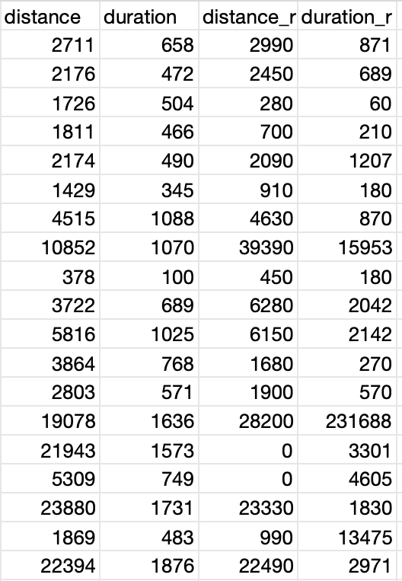
历史行车记录(现实) vs Gaode API数据
历史行车记录(现实): distance_r/duration_r
Gaode API数据：distance/duration
distance_ratio: distance_r / distance
duration_ratio: duration_r / duration

Slide 3
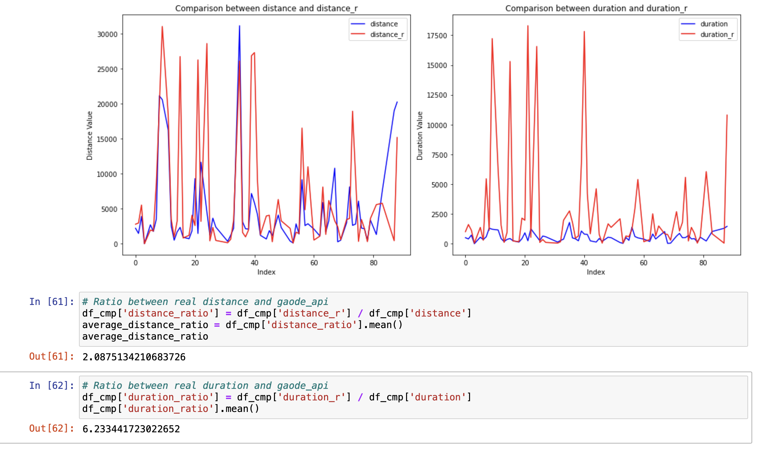
Result (Square search with side of 100m )
df_cmp['distance_r'] <= 40000 df_cmp['duration_r'] <= 40000
duration difference过大的原因：
1. 数据跨天了，table包括了9.1 - 9.12的数据
2. 在送货点卸货的时间未扣除

Slide 4
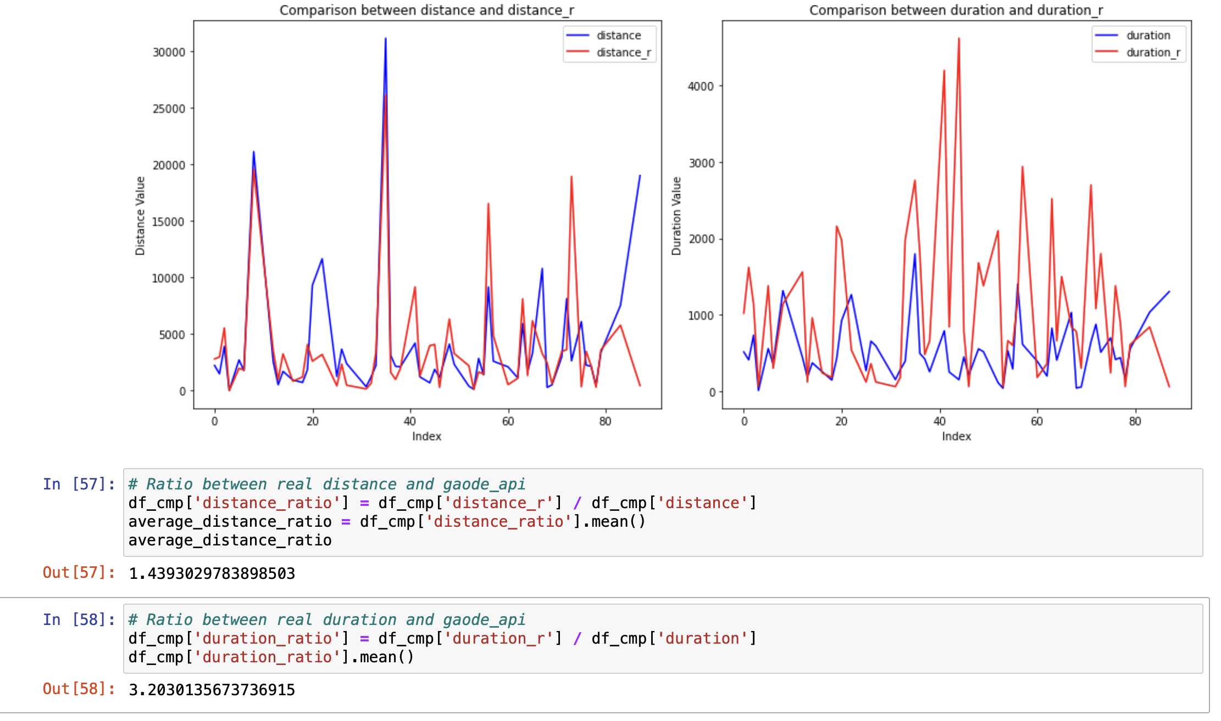
Result (Square search with side of 100m )
df_cmp['distance_r'] <= 40000 df_cmp['duration_r'] <= 5000

Slide 5
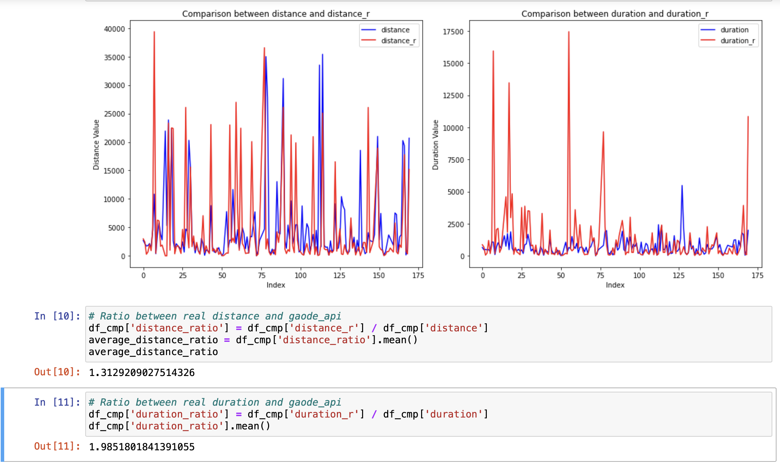
Result (Square search with side of 200m )
df_cmp['distance_r'] <= 40000 df_cmp['duration_r'] <= 40000

Slide 6
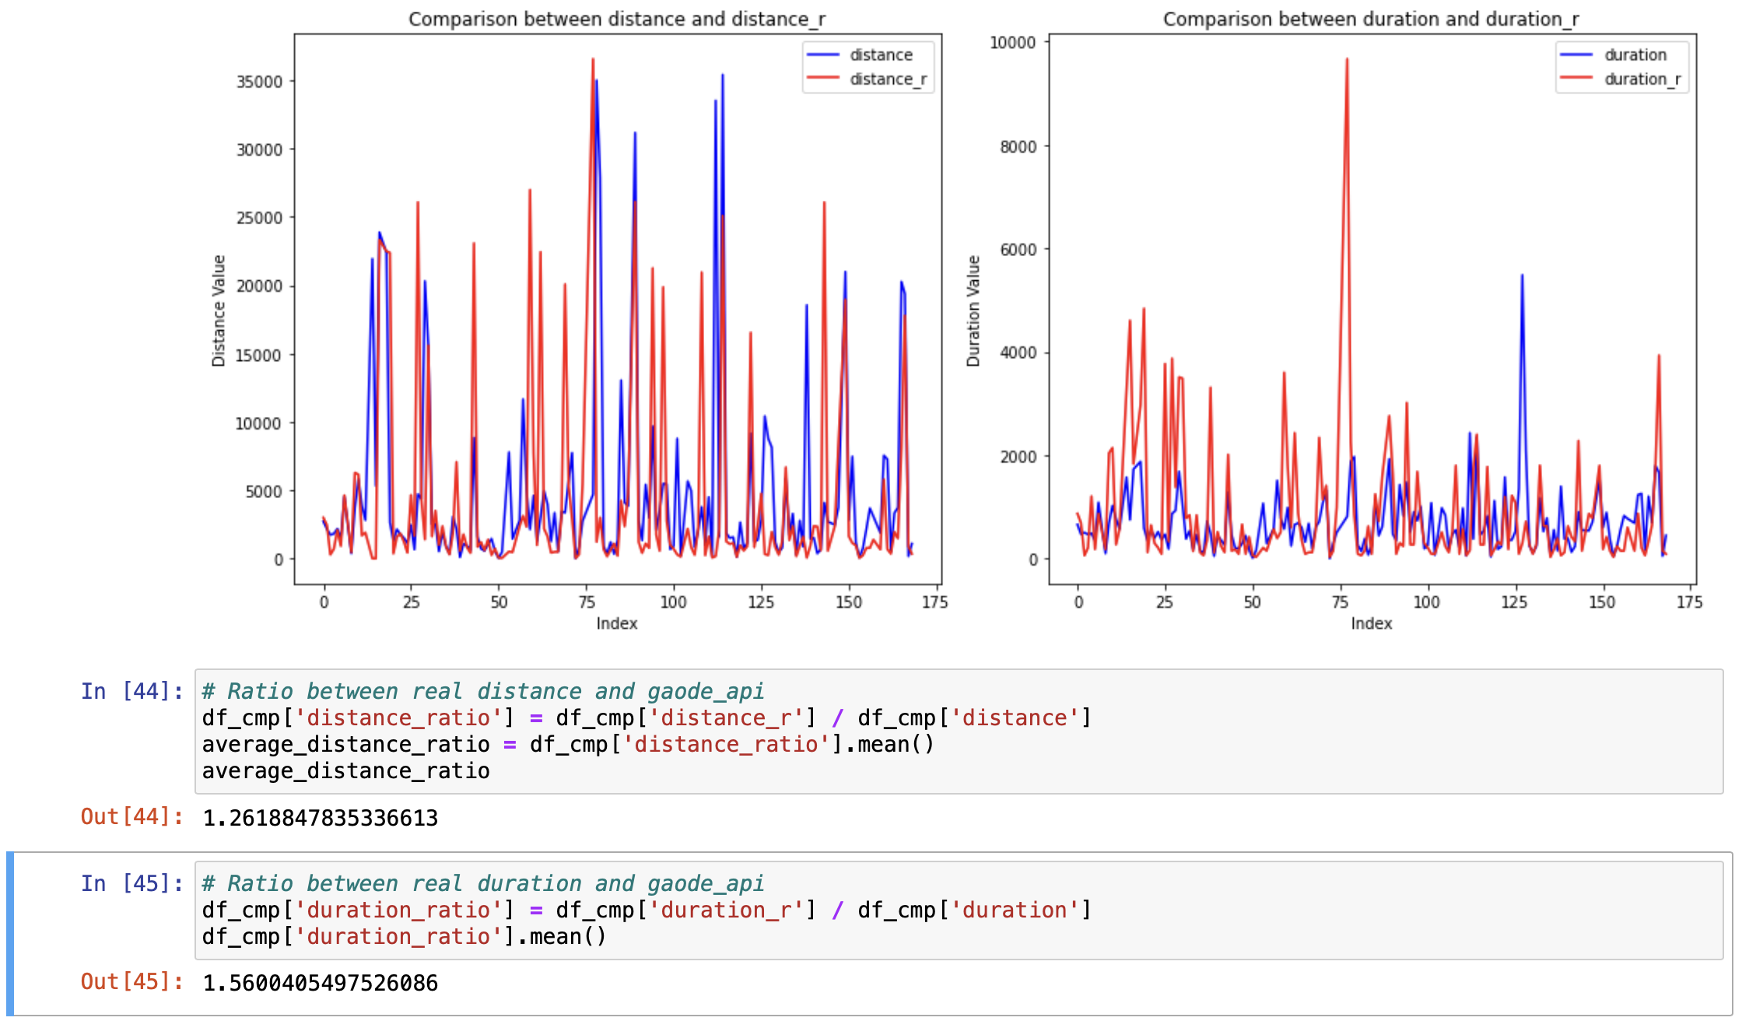
Result (Square search with side of 200m )
df_cmp['distance_r'] <= 40000 df_cmp['duration_r'] <= 10000

Slide 7
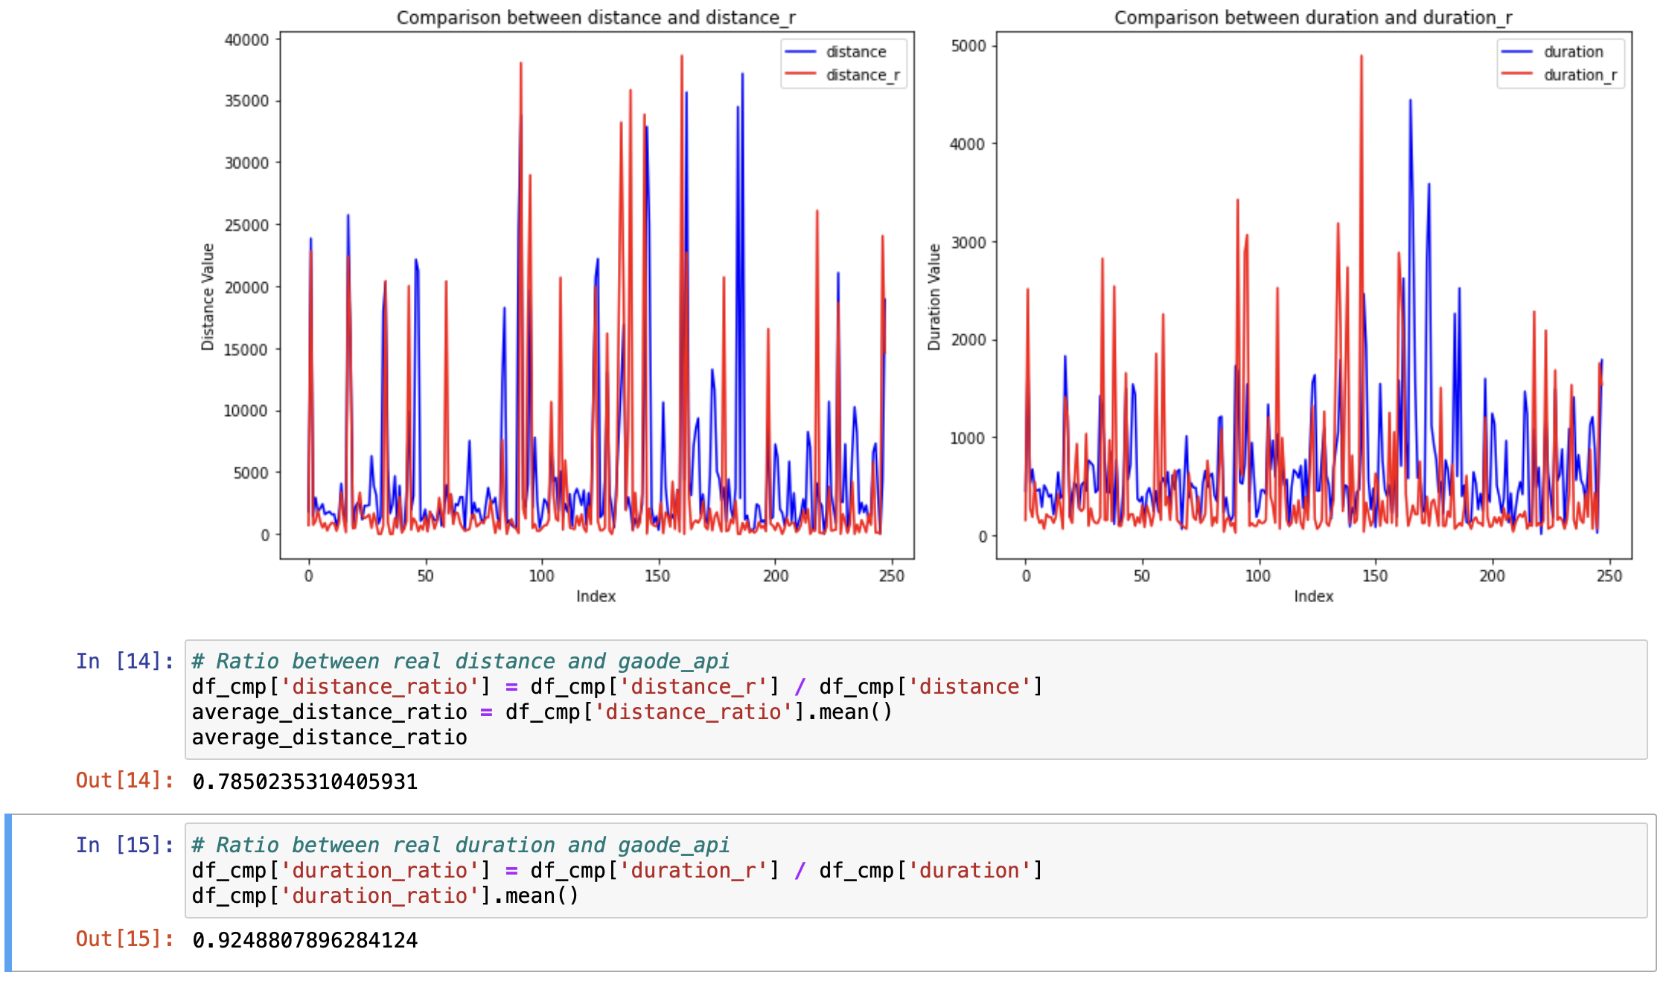
Result (Square search with side of 400m )
distance and duration ratio过小的原因：
1. 搜索面积过大，包括不属于路径上的点
2. 将短暂的停车点也当作了送货点（大概率是等红灯或者堵车）

Slide 8
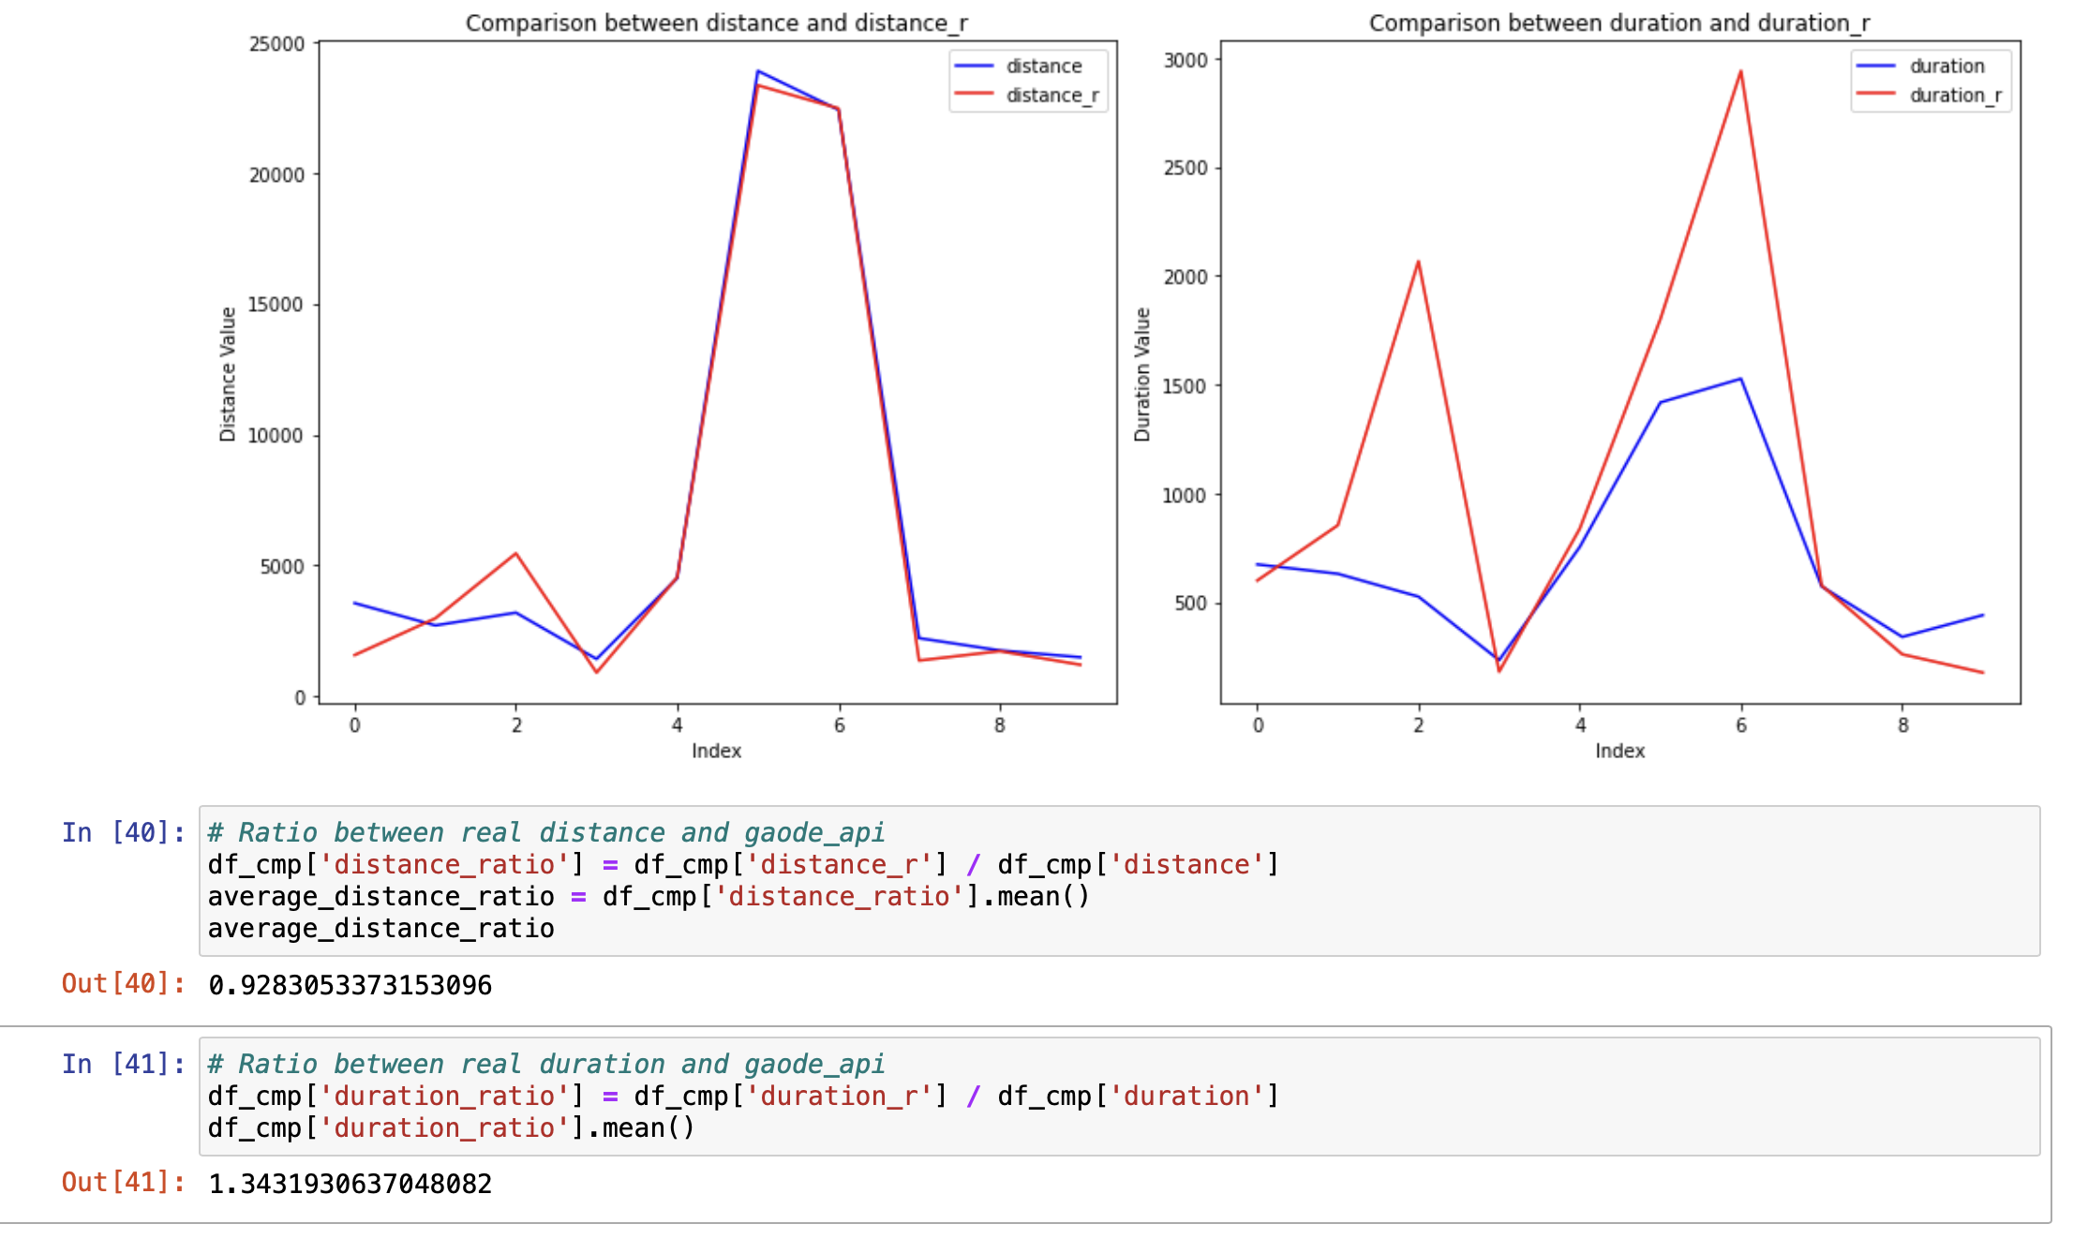
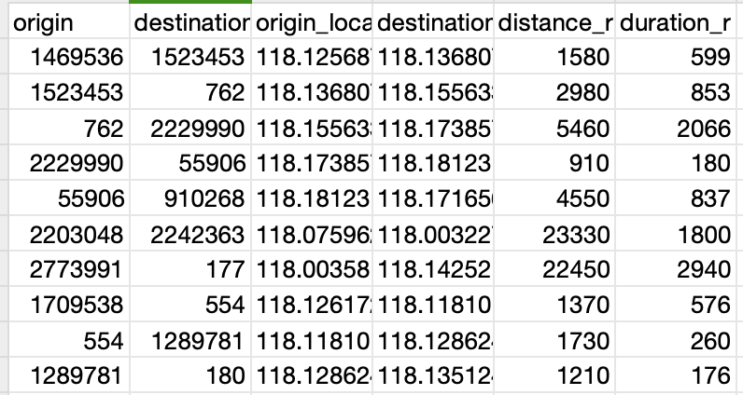
Manually check(Selected 10 pairs of data)

